Slide 1
SUB. CODE: UIT1401
TITLE: PRINCIPLES OF SOFTWARE ENGINEERING
Prepared By: Dr.V.Arulkumar, Asst.Prof, IT

Slide 2
COURSE OBJECTIVES
● To understand the process and its models.
● To understand fundamental concepts of requirements engineering and Analysis Modelling.
● To understand the major considerations for enterprise integration and deployment.
● To learn various testing and maintenance measures.

Slide 3


ENTITY RELATIONSHIP DIAGRAM (ERD)
An entity relationship diagram (ERD) shows the relationships of entity sets
stored in a database.
An entity in this context is an object, a component of data. An entity set is a
collection of similar entities. These entities can have attributes that define its
properties.
By defining the entities, their attributes, and showing the relationships between
them, an ER diagram illustrates the logical structure of databases.
COMMON ENTITY RELATIONSHIP DIAGRAM SYMBOLS
There are five main components of an ERD:
Entities, which are represented by rectangles. An entity is an object or concept about which you want to store information.
A weak entity is an entity that must defined by a foreign key relationship with another entity as it cannot be uniquely identified by its own attributes alone.

Slide 4

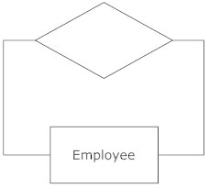

Actions, which are represented by diamond shapes, show how two entities share information in the database
In some cases, entities can be self-linked. For example, employees can supervise other employees.
Attributes, which are represented by ovals. A key attribute is the unique, distinguishing characteristic of the entity. For example, an employee's social security number might be the employee's key attribute.

Slide 5


A multivalued attribute can have more than one value. For example, an employee entity can have multiple skill values.
A derived attribute is based on another attribute. For example, an employee's monthly salary is based on the employee's annual salary.
Connecting lines, solid lines that connect attributes to show the relationships of entities in the diagram.

Slide 6
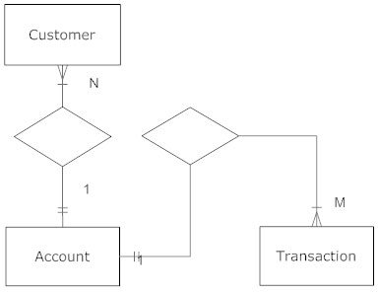
Cardinality specifies how many instances of an entity relate to one instance of another entity.
Ordinality is also closely linked to cardinality. While cardinality specifies the occurrences of a relationship, ordinality describes the relationship as either mandatory or optional.
In other words, cardinality specifies the maximum number of relationships and ordinality specifies the absolute minimum number of relationships.

Slide 7
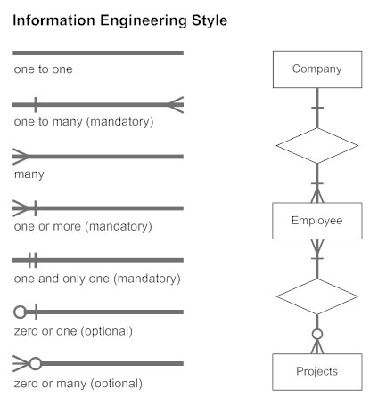
INFORMATION ENGINEERING STYLE
There are many notation styles that express cardinality.
Information Engineering Style

Slide 8
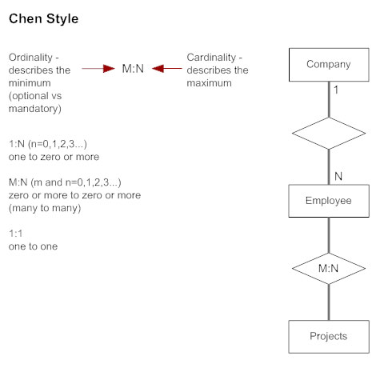
CHEN STYLE

Slide 9
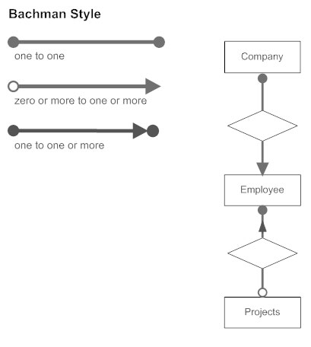
BACHMAN STYLE

Slide 10
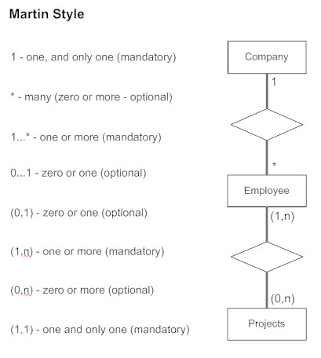
MARTIN STYLE

Slide 11
ER DIAGRAM USES
When documenting a system or process, looking at the system in multiple ways increases the understanding of that system.
ERD diagrams are commonly used in conjunction with a data flow diagram to display the contents of a data store.
They help us to visualize how data is connected in a general way, and are particularly useful for constructing a relational database.

Slide 12

PRACTICE TIPS FOR CONSTRUCTING AN ERD:
Identify the entities. The first step in making an ERD is to identify all of the entities you will use.
An entity is nothing more than a rectangle with a description of something that your system stores information about.
This could be a customer, a manager, an invoice, a schedule, etc. Draw a rectangle for each entity you can think of on your page.
Keep them spaced out a bit.
Identify relationships. Look at two entities, are they related? If so draw a solid line connecting the two entities.
Describe the relationship. How are the entities related? Draw an action diamond between the two entities on the line you just added. In the diamond write a brief description of how they are related.

Slide 13
Add attributes. Any key attributes of entities should be added using oval-shaped symbols.
Complete the diagram. Continue to connect the entities with lines, and adding diamonds to describe each relationship until all relationships have been described. Each of your entities may not have any relationships, some may have multiple relationships.
TIPS FOR EFFECTIVE ER DIAGRAMS
Make sure that each entity only appears once per diagram.
Name every entity, relationship, and attribute on your diagram.
Examine relationships between entities closely. Are they necessary? Are there
any relationships missing? Eliminate any redundant relationships. Don't connect
relationships to each other.
Use colors to highlight important portions of your diagram

Slide 14
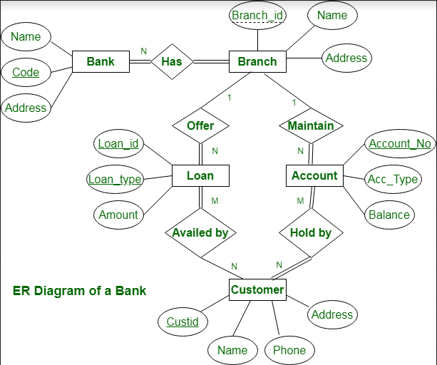
EXAMPLE 1

Slide 15
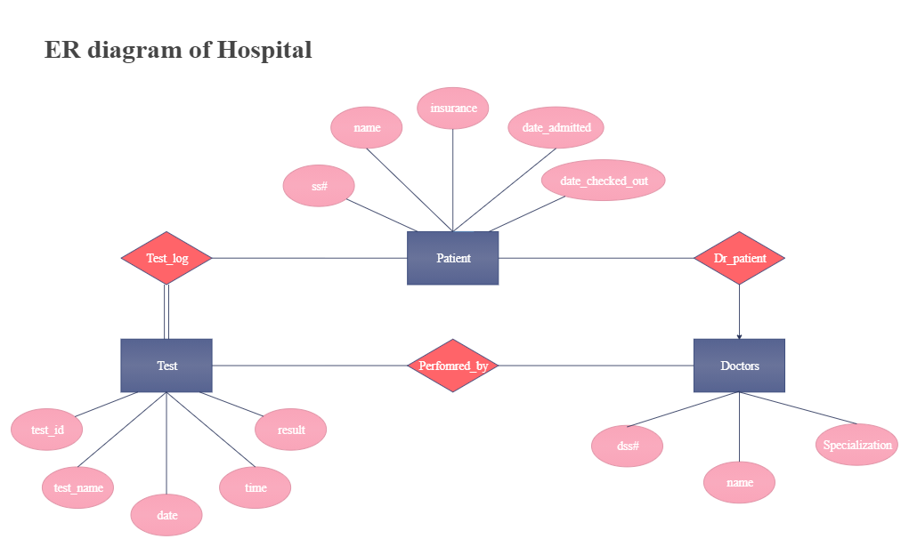
EXAMPLE 2

Slide 16
REFERENCE
Roger S. Pressman, Software Engineering – A practitioner’s Approach, Seventh Edition, McGraw-Hill International Edition, 2010.
Ian Sommerville, Software Engineering, 9th Edition, Pearson Education Asia, 2011.

